Slide 1
Phishing Awareness and training

Slide 2
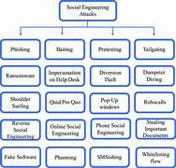
Introduction of Social Engineering Attacks
Social engineering is the act of “human hacking” to commit fraud
Hackers use deceptive psychological manipulation to instill fear, excitement, or urgency. Once you're in a heightened emotional state, they'll use that against you to cloud your better judgment.

Slide 3
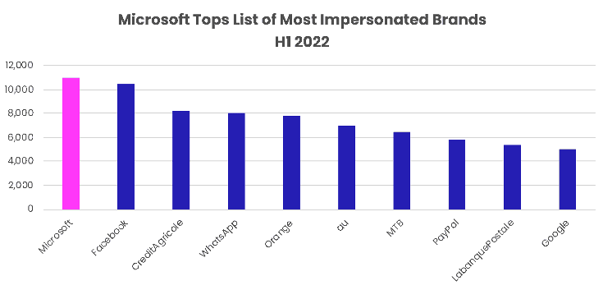
Phishing Attacks
Phishing is the most common type of social engineering tactic and has increased more than tenfold in the past three years, according to the FBI
Phishing attacks occur when scammers use any form of communication (usually emails) to “fish” for information. These messages look identical to ones from trusted sources like organizations and people you know.

Slide 4
Spear Phishing
Normal phishing attacks have no specific target. But spear phishing attacks occur when hackers target a specific individual or organization.
Nearly 60% of IT decision-makers believe targeted phishing attacks are their top security threat.
During 2015, hackers completed a $1 billion heist spanning 40 countries with spear phishing. The scammers sent bank employees phishing emails with an attachment to deploy Carbanak malware. Once clicked, the hackers could control the employees’ workstations and were able to infect ATM servers remotely.

Slide 5
Whaling Attacks
Whaling is a term used to describe phishing attacks that target a specific, high-profile person. Usually, an executive, government official or celebrity.
The victims of whaling attacks are considered “big fish” to cybercriminals. These targets offer great potential to scammers with either large financial payouts or access to valuable data.
In the case of hacked celebrities, scammers hope to find compromising photos that they can use to extort exorbitant ransoms.

Slide 6
Vishing Attacks
Vishing which is short for “voice phishing” is a type of social engineering attack in which scammers phone you and attempt to trick you into sharing personal information, sending them money, or giving them remote access to your computer.
Scammers will typically call you pretending to be a company or government agency that you trust like Amazon or the IRS. Once they have you on the phone, they try to manipulate you in a number of ways.
While most people know by now not to click on suspicious links in phishing emails or texts messages they’re not always as careful over the phone.

Slide 7
Baiting Attack
Baiting is a type of social engineering attack in which scammers lure victims into providing sensitive information by promising them something valuable in return.
For example, scammers will create pop-up ads that offer free games, music, or movie downloads. If you click on the link, your device will be infected with malware.
Baiting scams also exist in the physical world.
One common example is a strategically placed USB stick with an enticing label like “Payroll Q3” or “Master client database.”

Slide 8
Honey Trap Attacks
Honey traps are a type of romance scam in which scammers create fake online dating and social media profiles using attractive stolen photos
Once they identify a target, they’ll start sending flirty and provocative messages, and quickly tell their victims they’re in love with them. But, they need the victims to prove they feel the same way by sending gifts, cash, or cryptocurrency.
Honeytraps are especially rampant on social media sites like Snapchat. Make sure you're always staying safe and are aware of the dangers of online dating.

Slide 9
Conclusion
Phishing attacks are notoriously difficult to prevent because they rely on human psychology rather than technological pathways. The attack surface is also significant in a larger organization, it takes just one employee's mistake to compromise the integrity of the entire enterprise network. Some of the steps experts recommend to mitigate the risk and success of social engineering scams include:
Security awareness training: Educating others about recognizing and avoiding phishing emails, websites, and social engineering tactics is crucial in today's digital age where cyber threats are prevalent. Many users don't know how to identify social engineering attacks. And in a time when users frequently trade personal information for goods and services, they don’t realize that surrendering seemingly mundane information.
Access control policies: Secure access control policies and technologies, including multi-factor authentication, adaptive authentication and a zero trust security approach can limit cybercriminals' access to sensitive information.
Cybersecurity technologies: Spam filters and secure email gateways can prevent some phishing attacks from reaching employees in the first place. Firewalls and antivirus software can mitigate the extent of any damage done by attackers who gain access to the network.

